Slide 1
Common Birds of the Chihuahuan Desert
Dylan Osterhaus, PhD Student, dylano@nmsu.edu
Kelley Boland, MS Student, kcboland@nmsu.edu
New Mexico State University

Slide 2
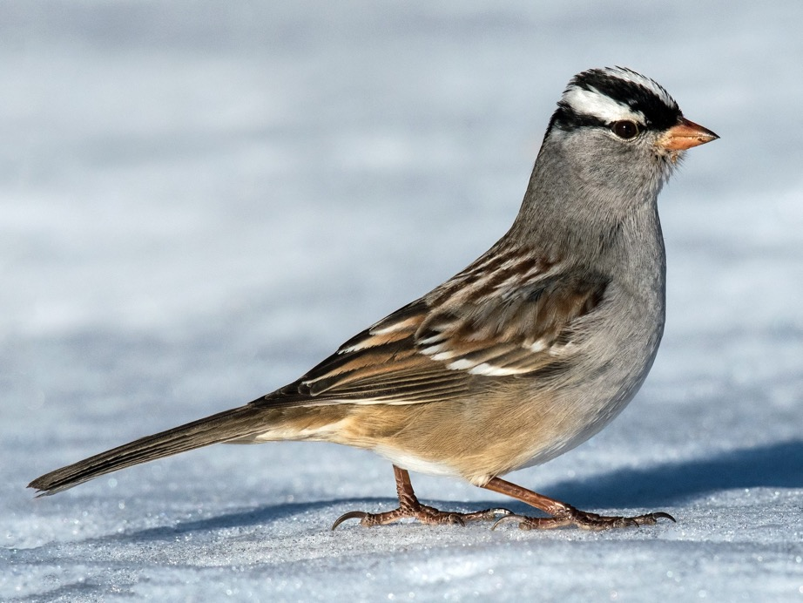
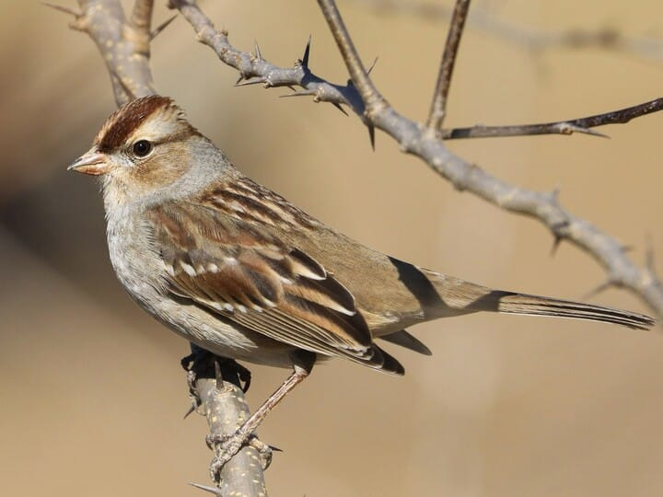
White-crowned Sparrow
Adult
Immature

Slide 3
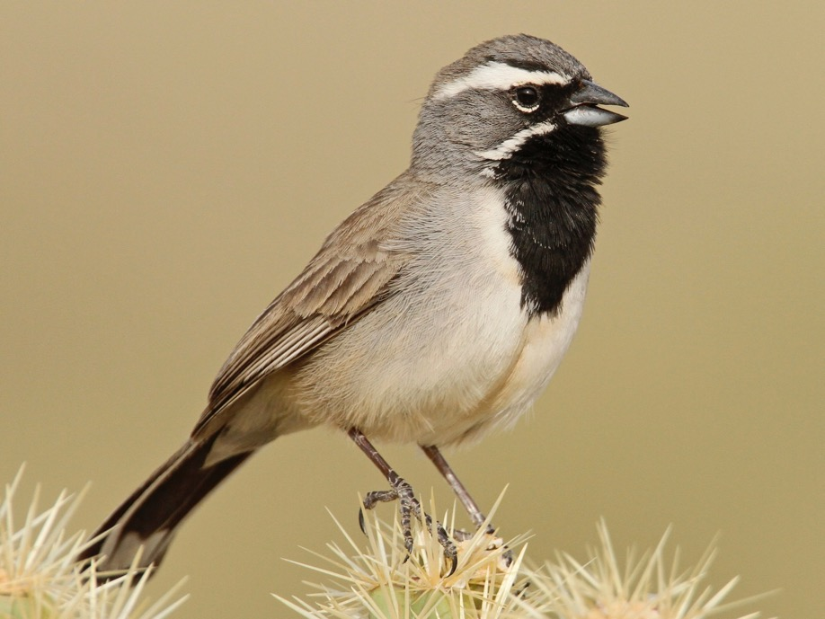
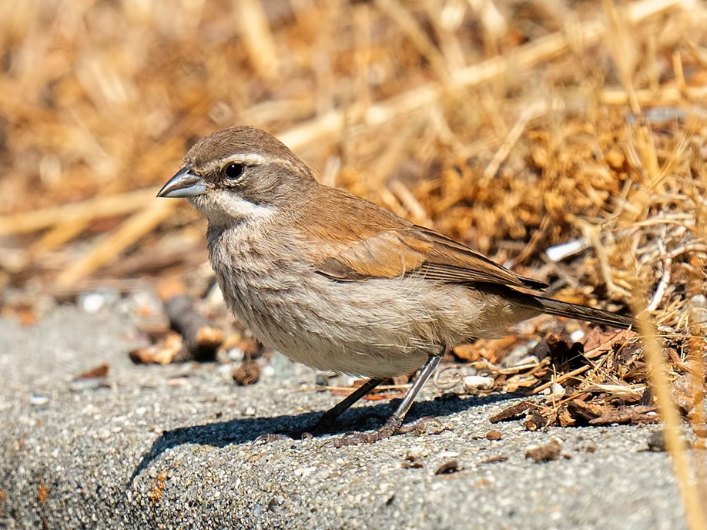
Black-throated Sparrow
Adult
Juvenile

Slide 4
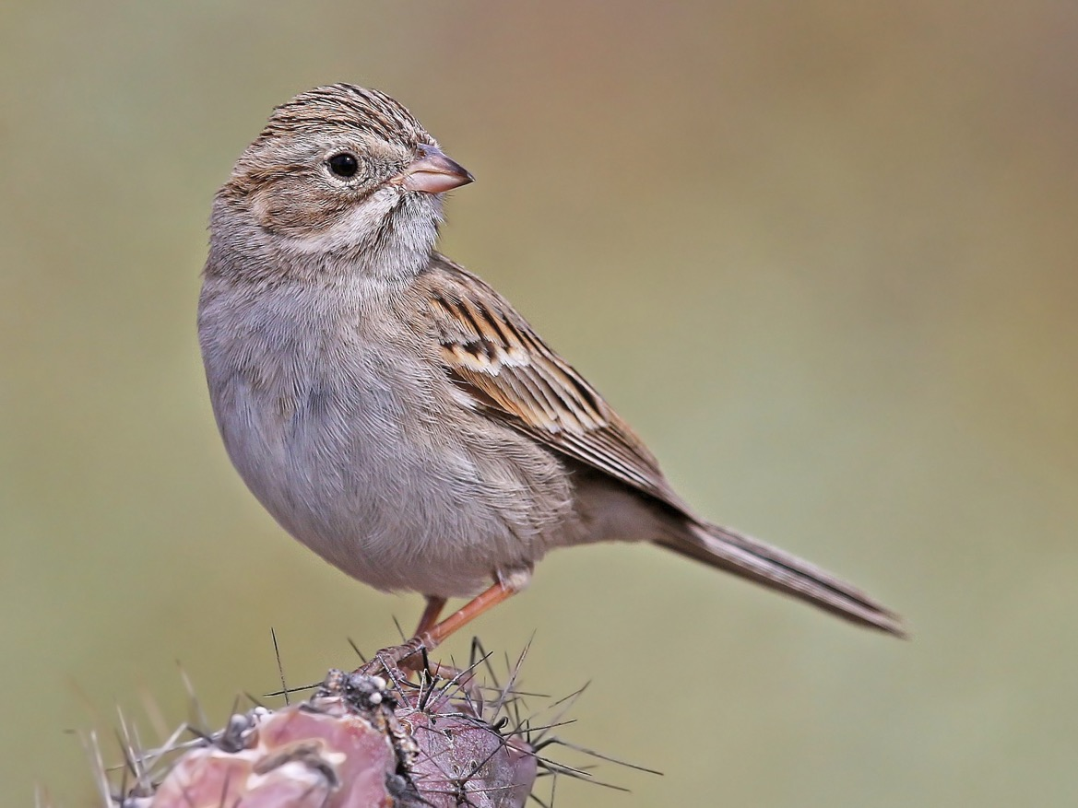
Brewer’s Sparrow

Slide 5
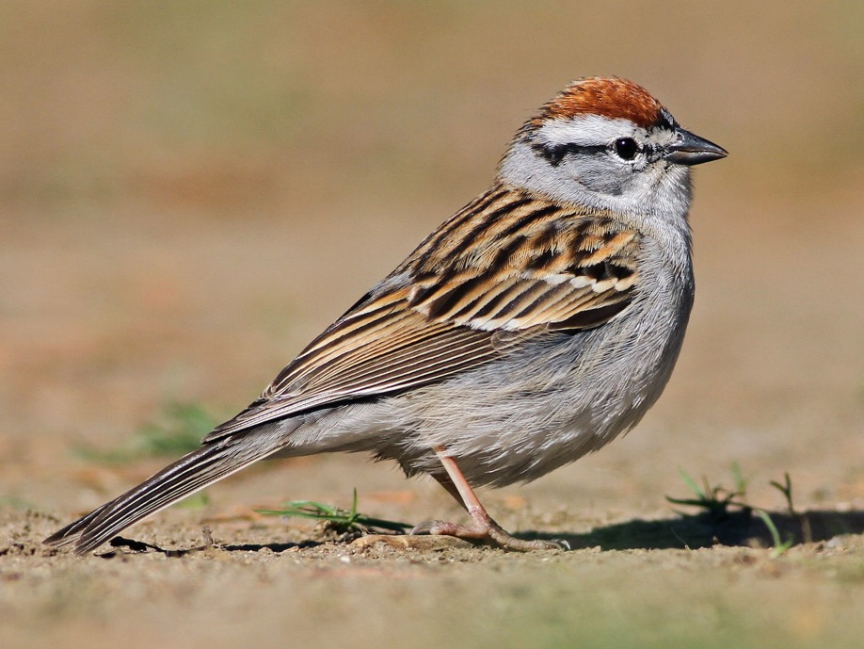
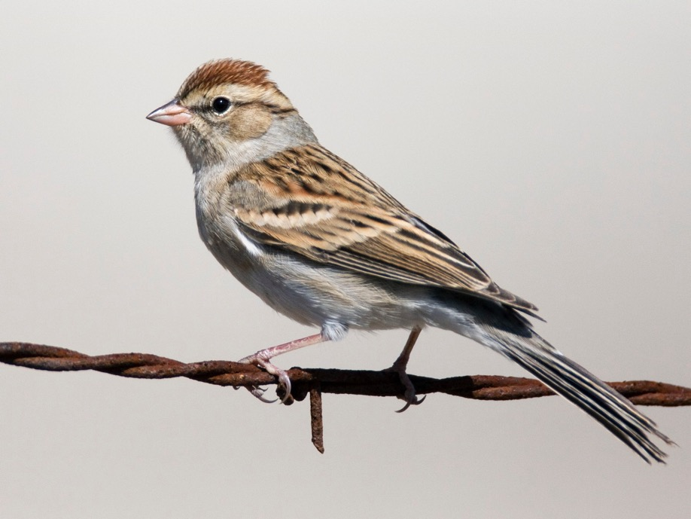
Chipping Sparrow
Breeding Adult
Nonbreeding Adult/Immature

Slide 6
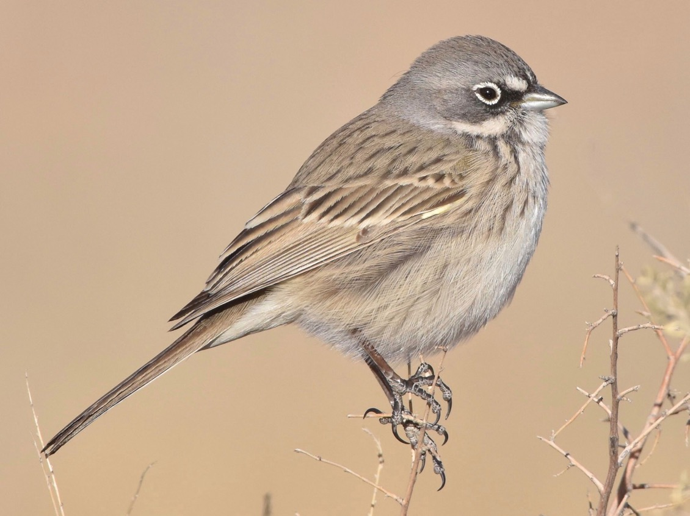
Sagebrush Sparrow

Slide 7
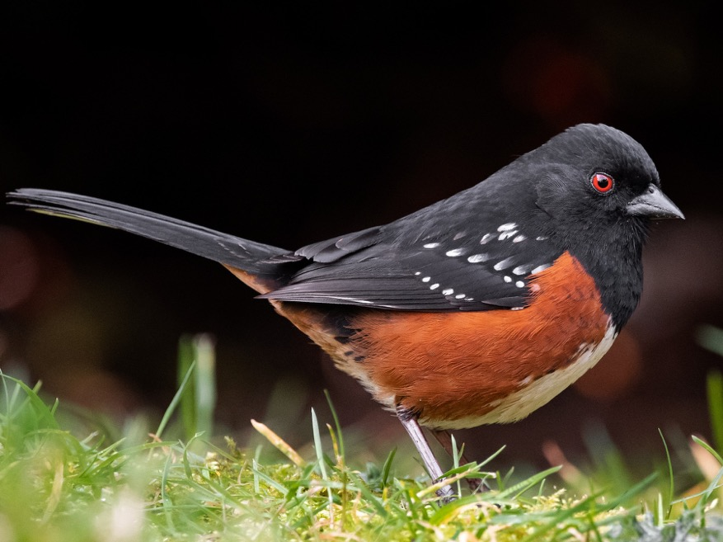
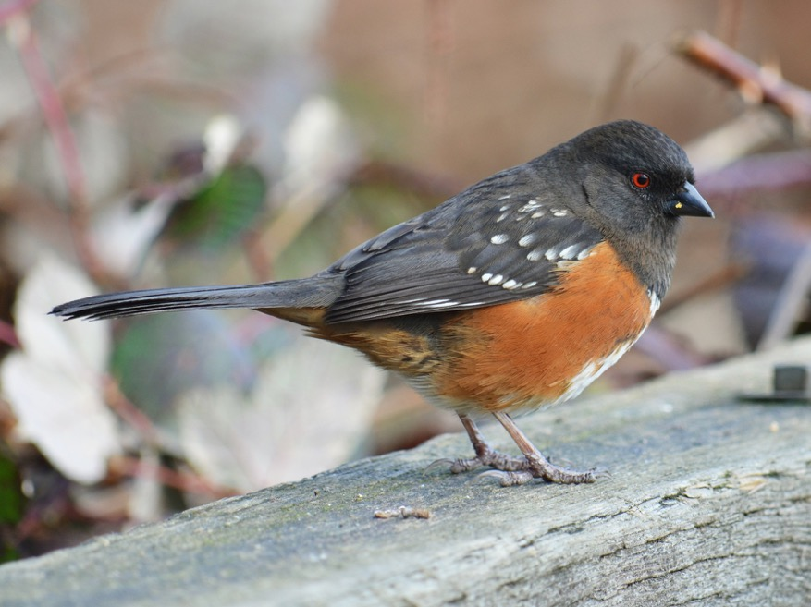
Spotted Towhee
Adult Male
Female/Immature

Slide 8
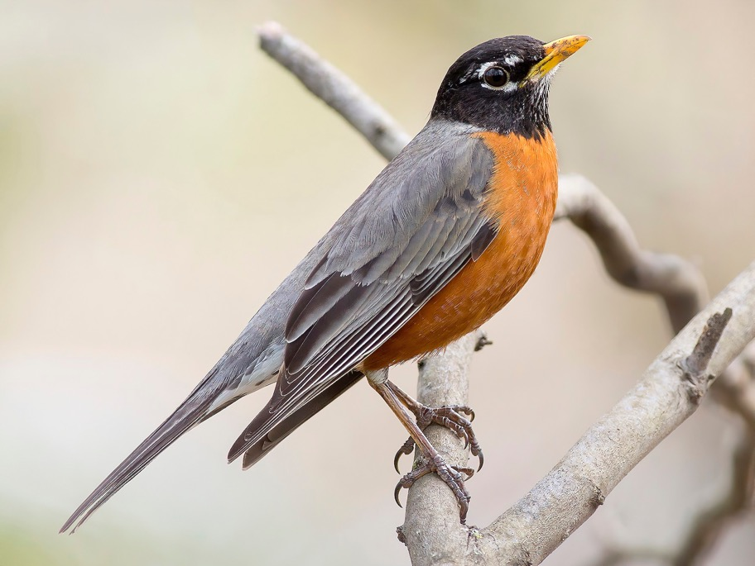
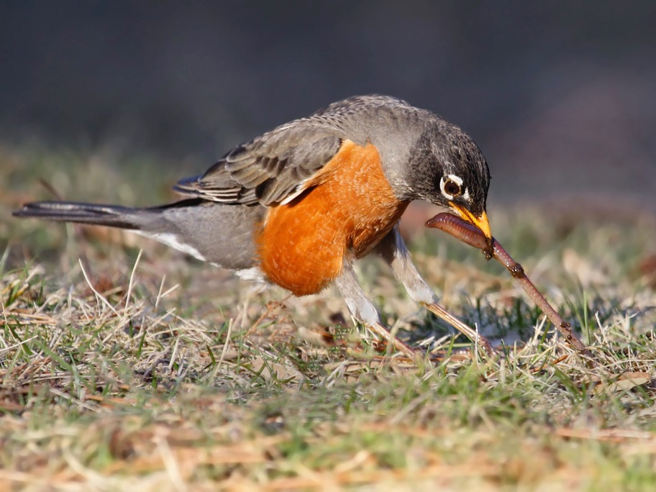
American Robin

Slide 9
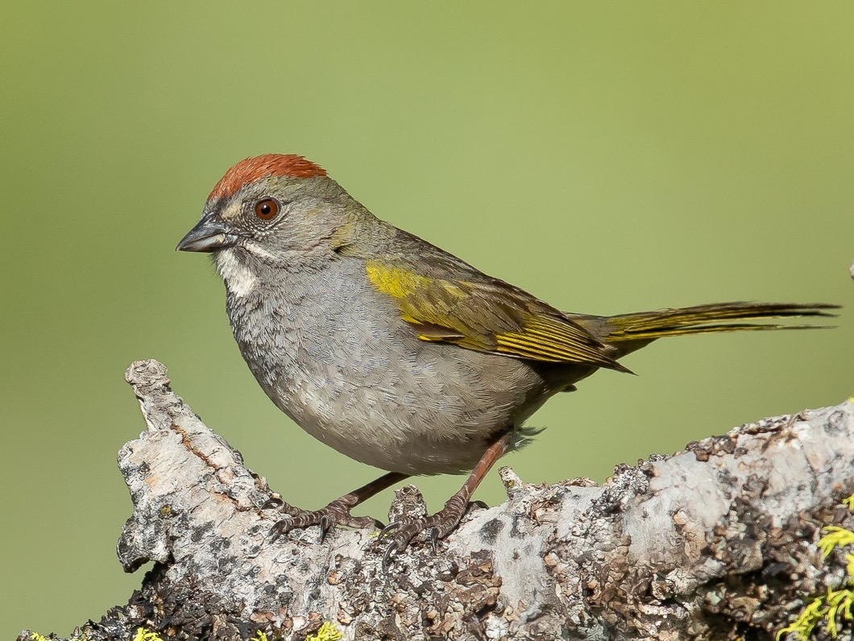
Green-tailed Towhee

Slide 10
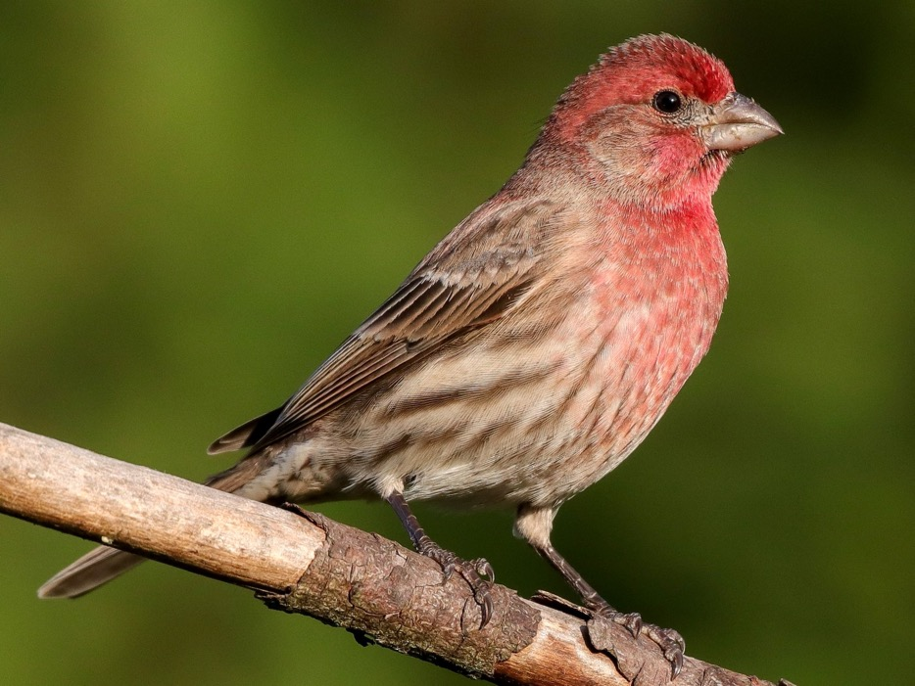
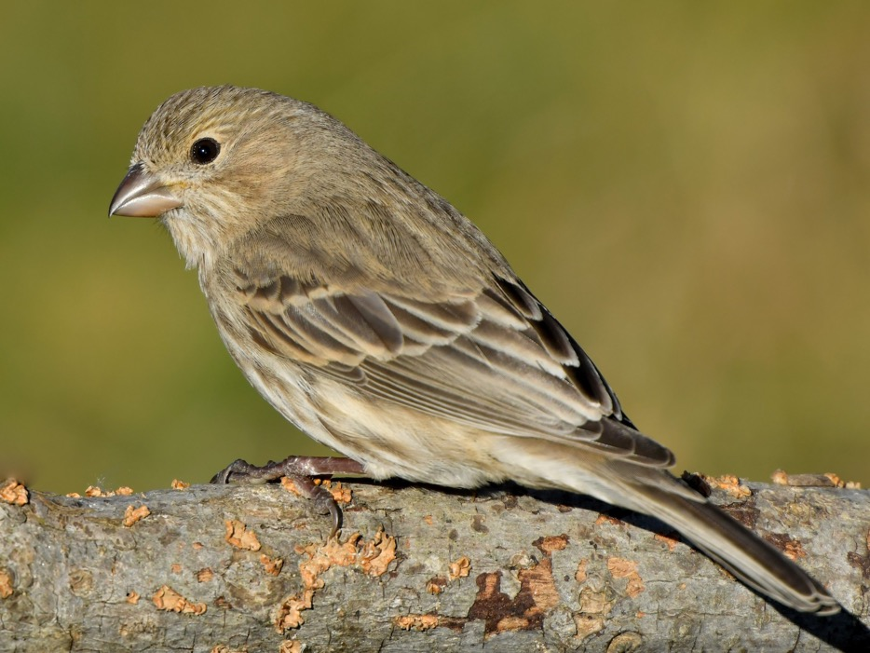
House Finch
Male
Female/Immature

Slide 11
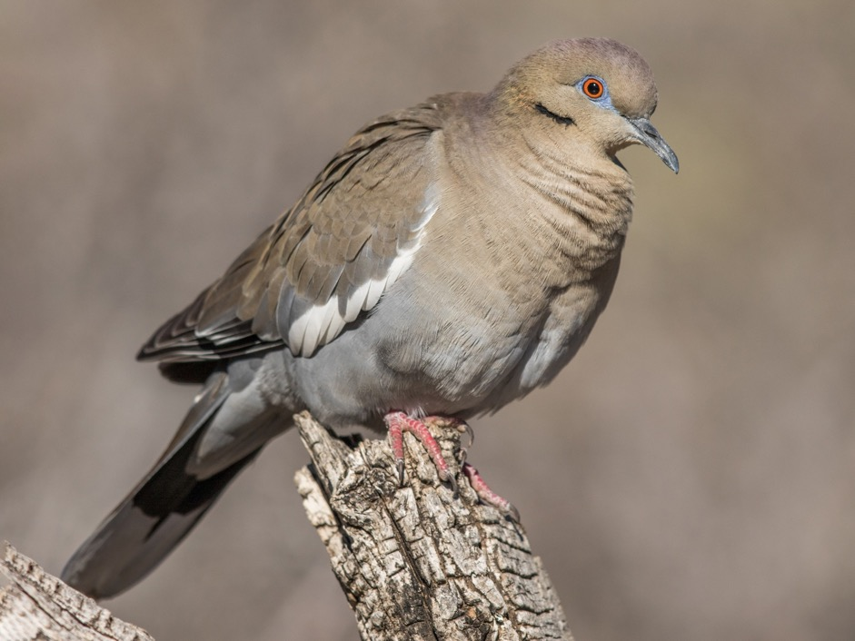
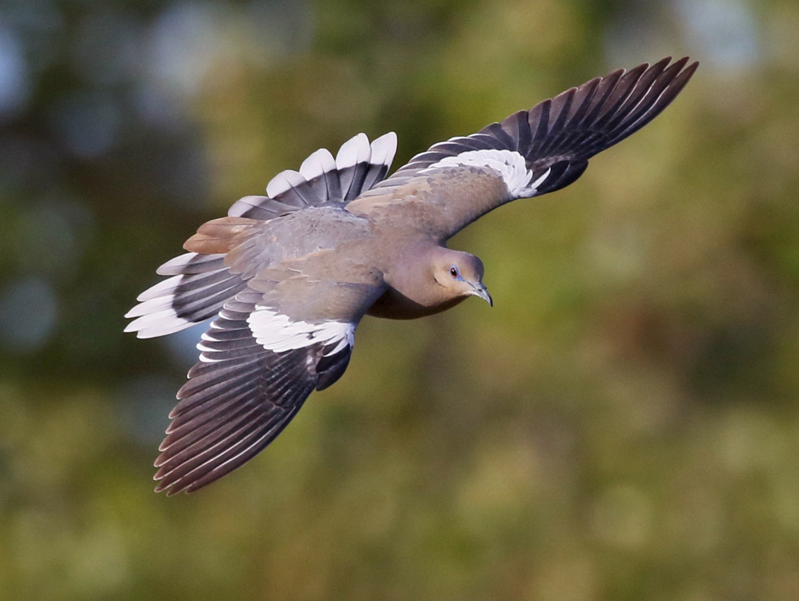
White-winged Dove

Slide 12
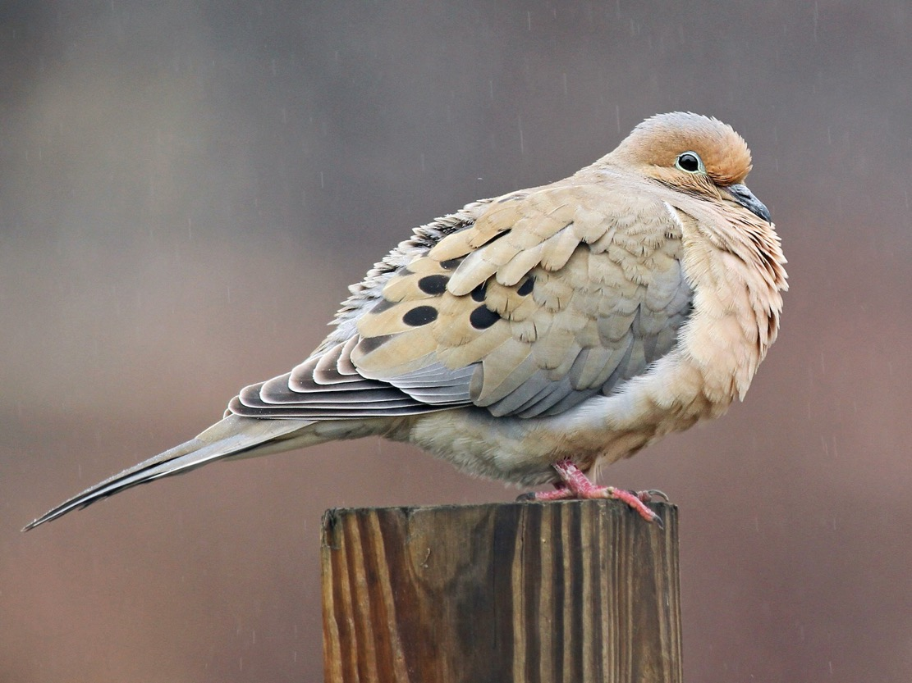
Mourning Dove

Slide 13
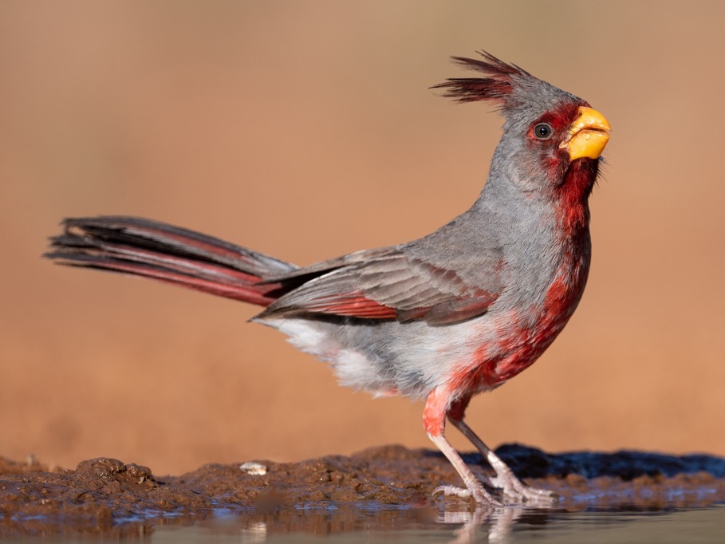
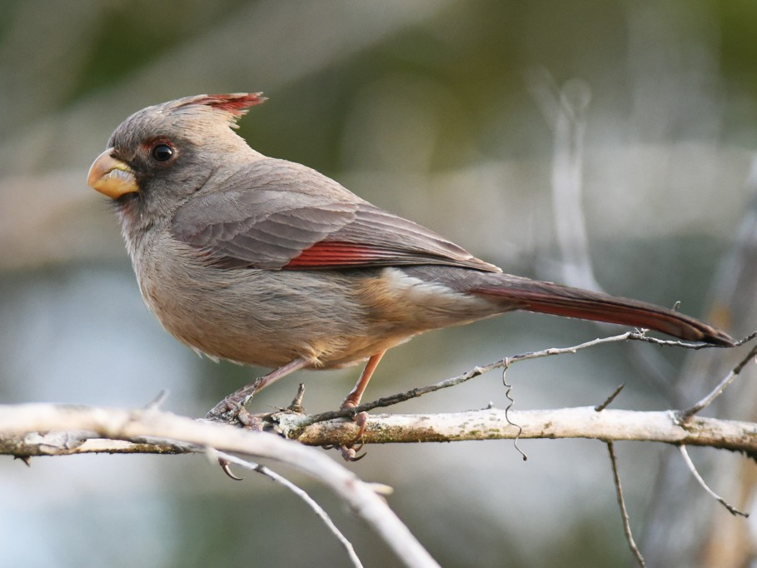
Pyrrhuloxia
Male
Female

Slide 14
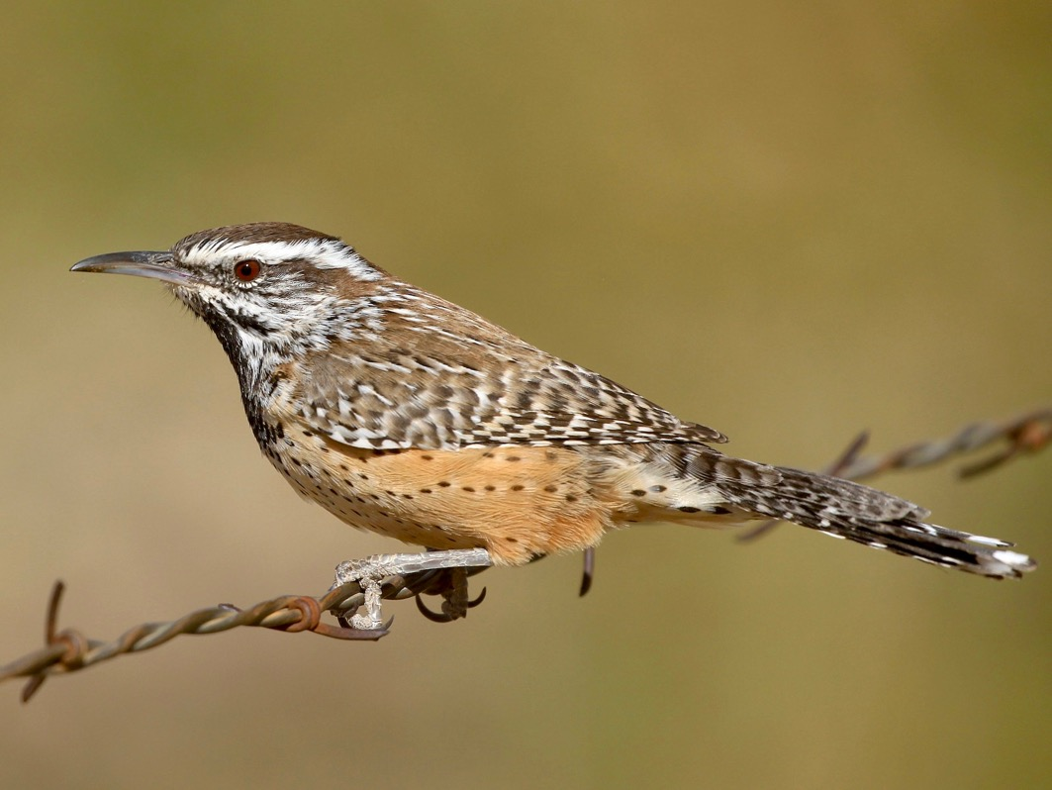
Cactus Wren

Slide 15
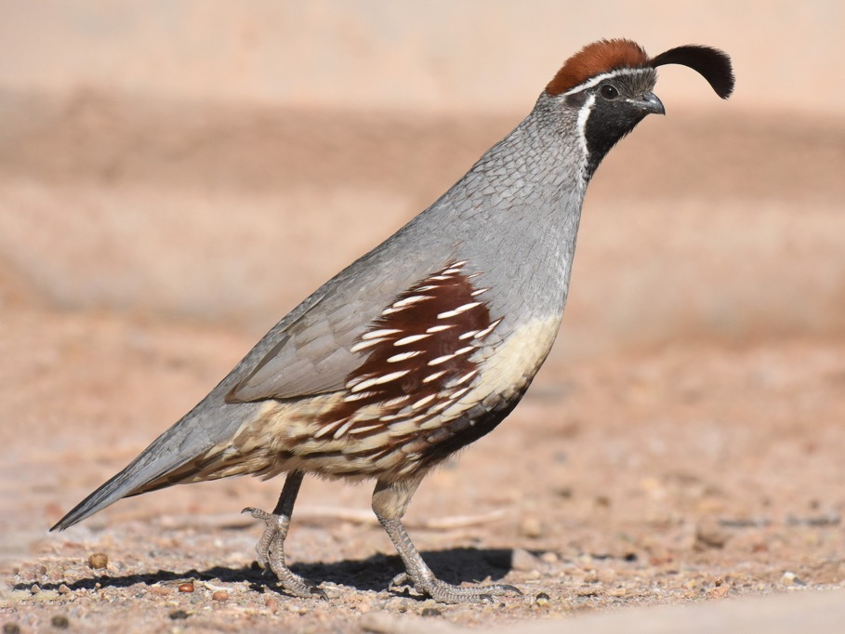
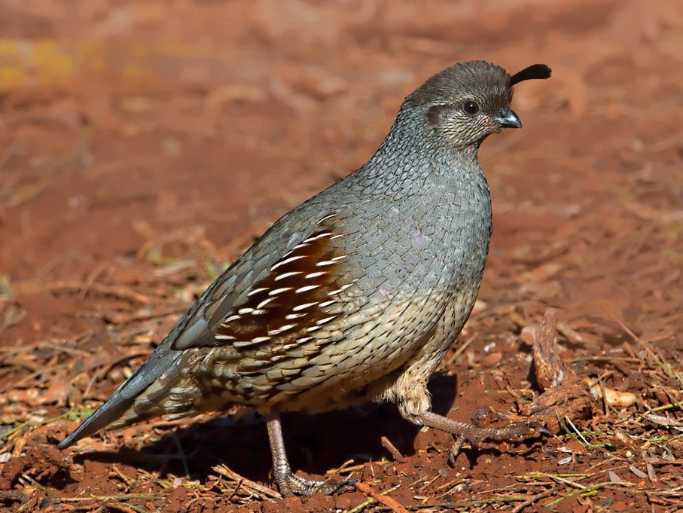
Gambel’s Quail
Male
Female

Slide 16
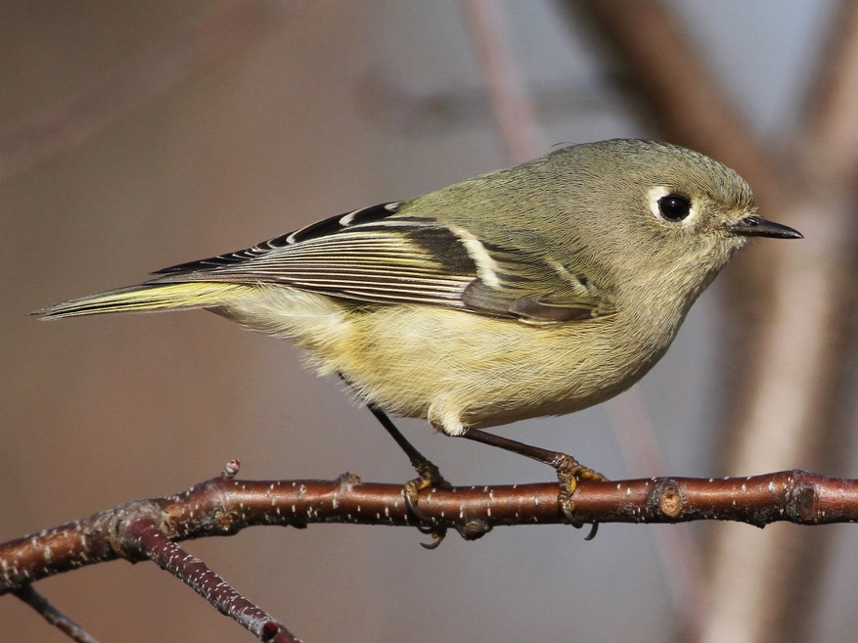
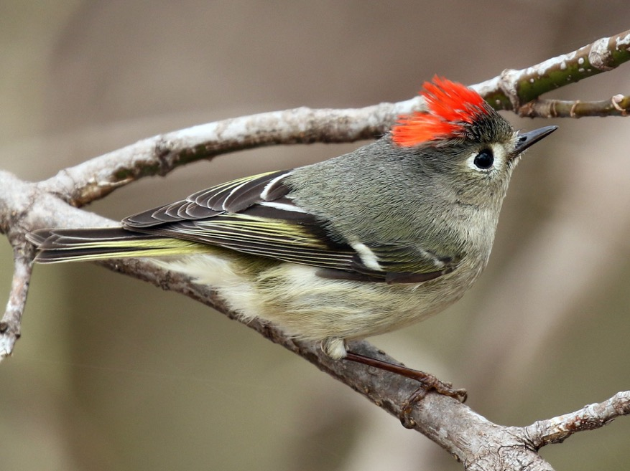
Ruby-crowned Kinglet
Adult
Adult Male

Slide 17
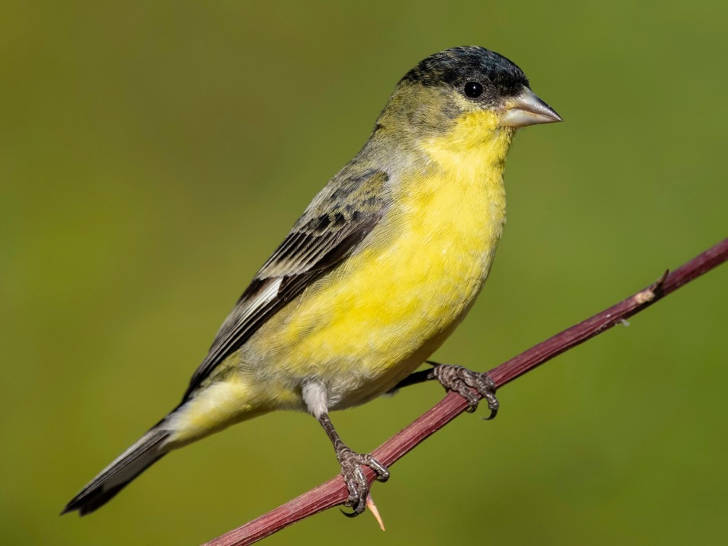
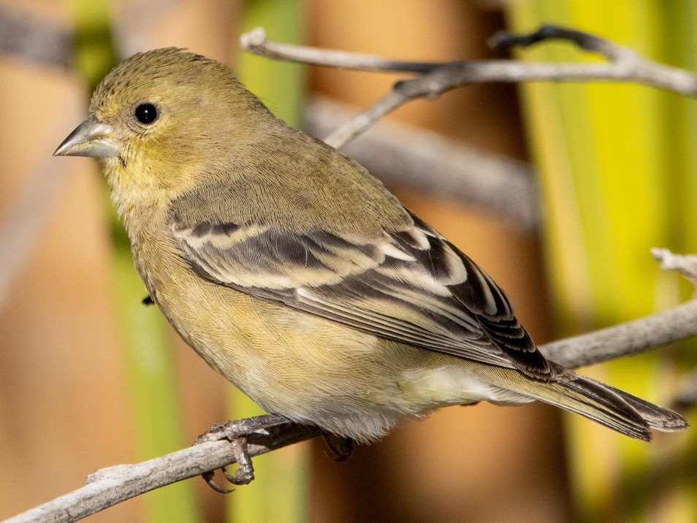
Lesser Goldfinch
Adult Male
Female/Immature

Slide 18
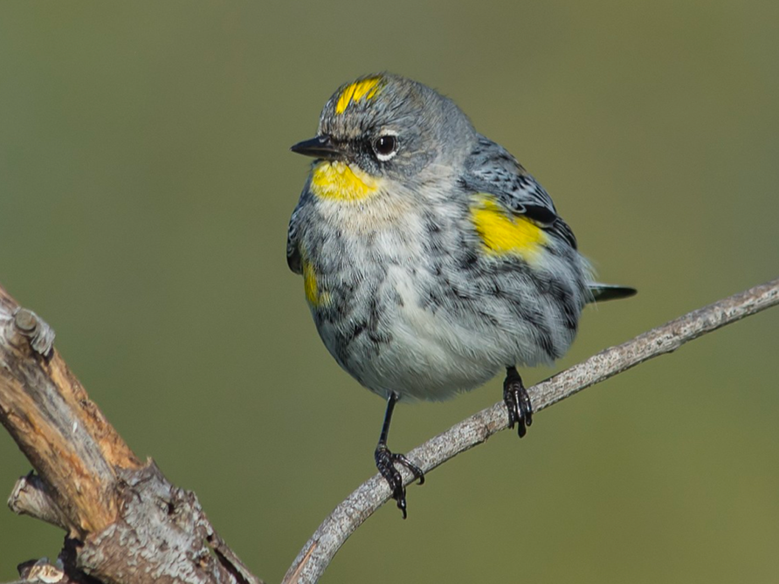
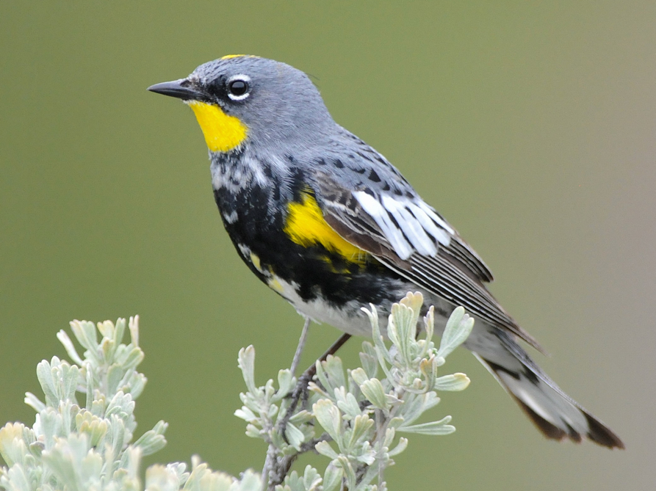
Yellow-rumped Warbler

Slide 19
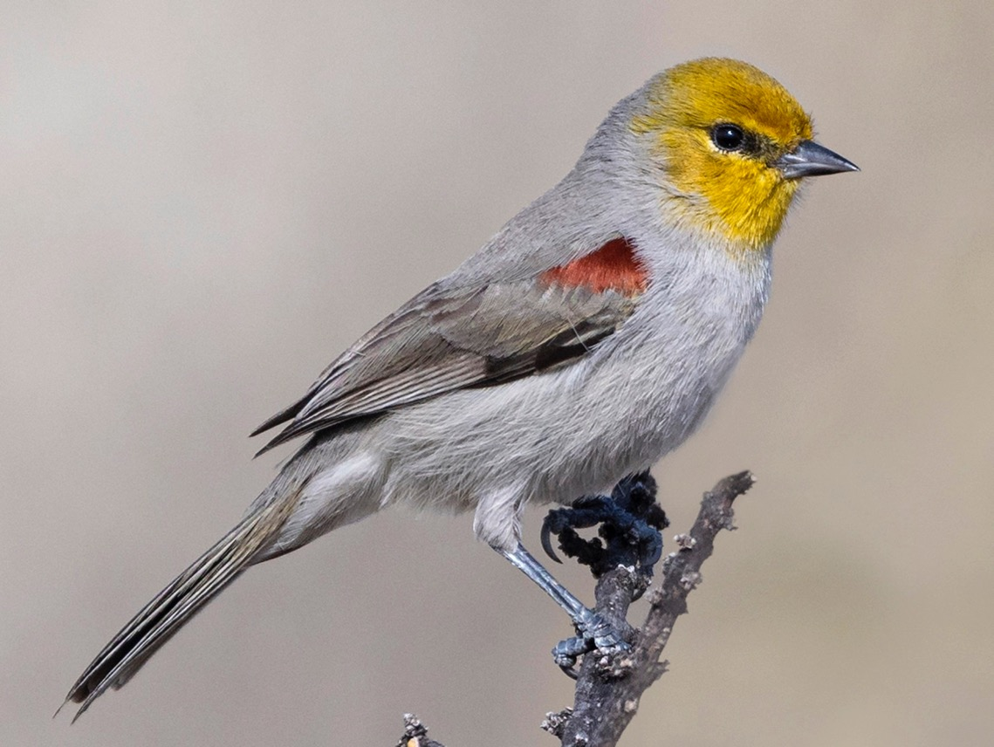
Verdin

Slide 20
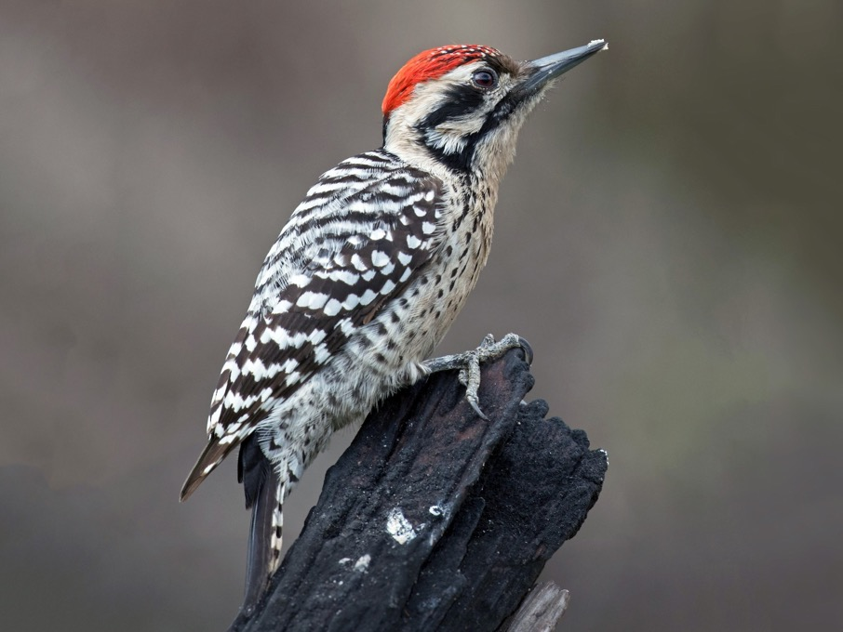
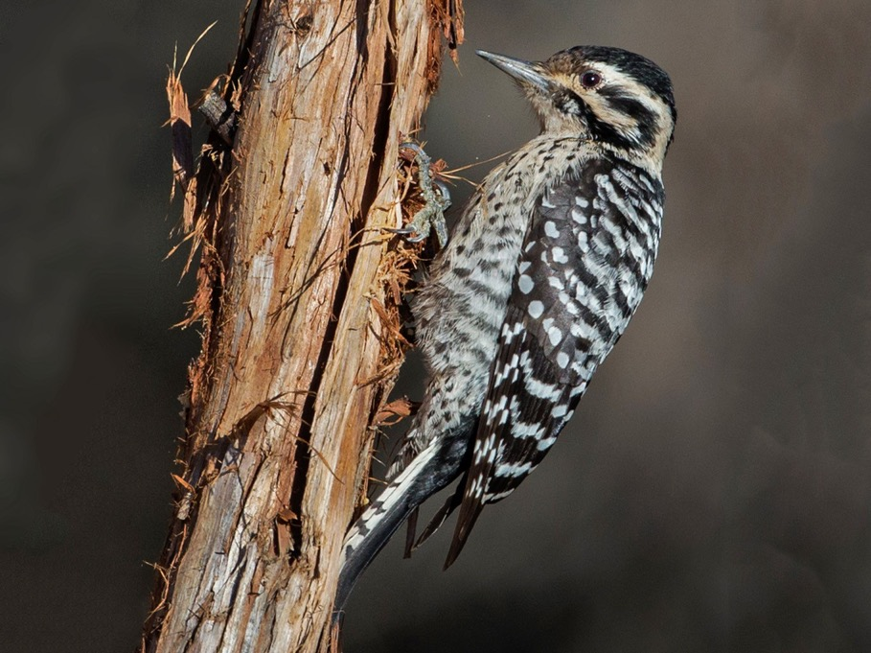
Ladder-backed Woodpecker
Male
Female

Slide 21
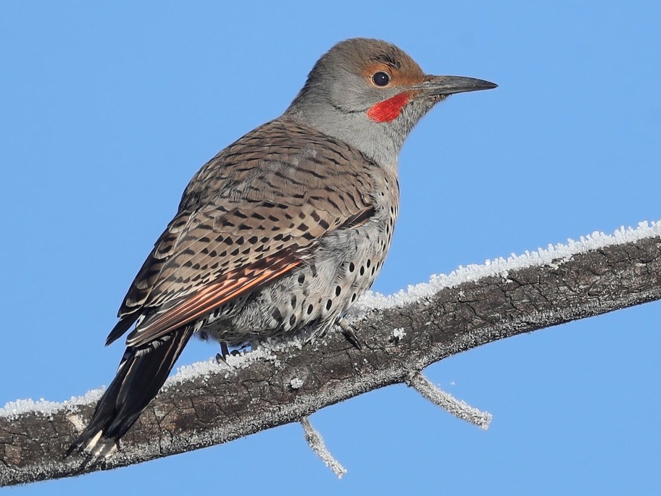
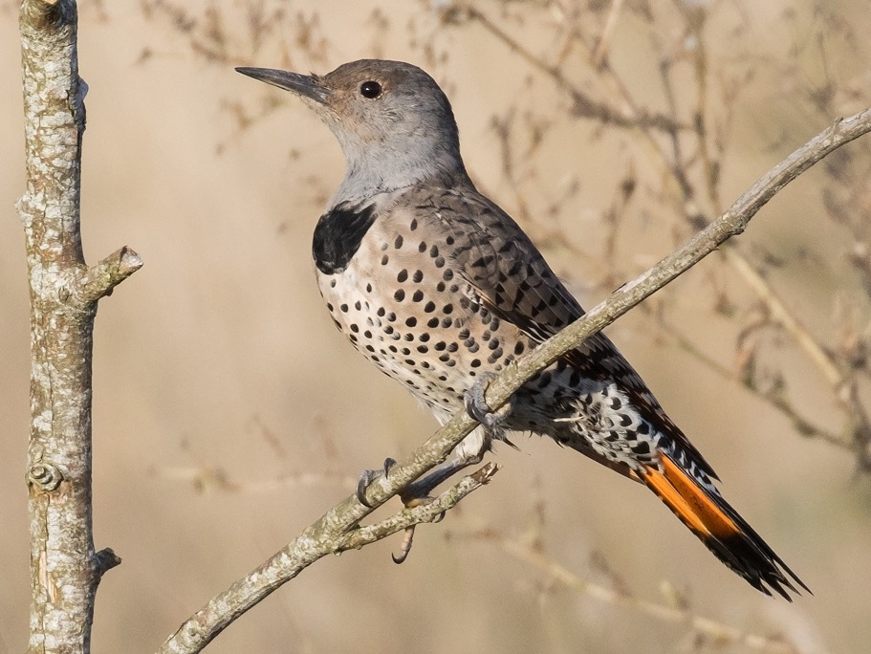
Northern Flicker
Male
Female

Slide 22
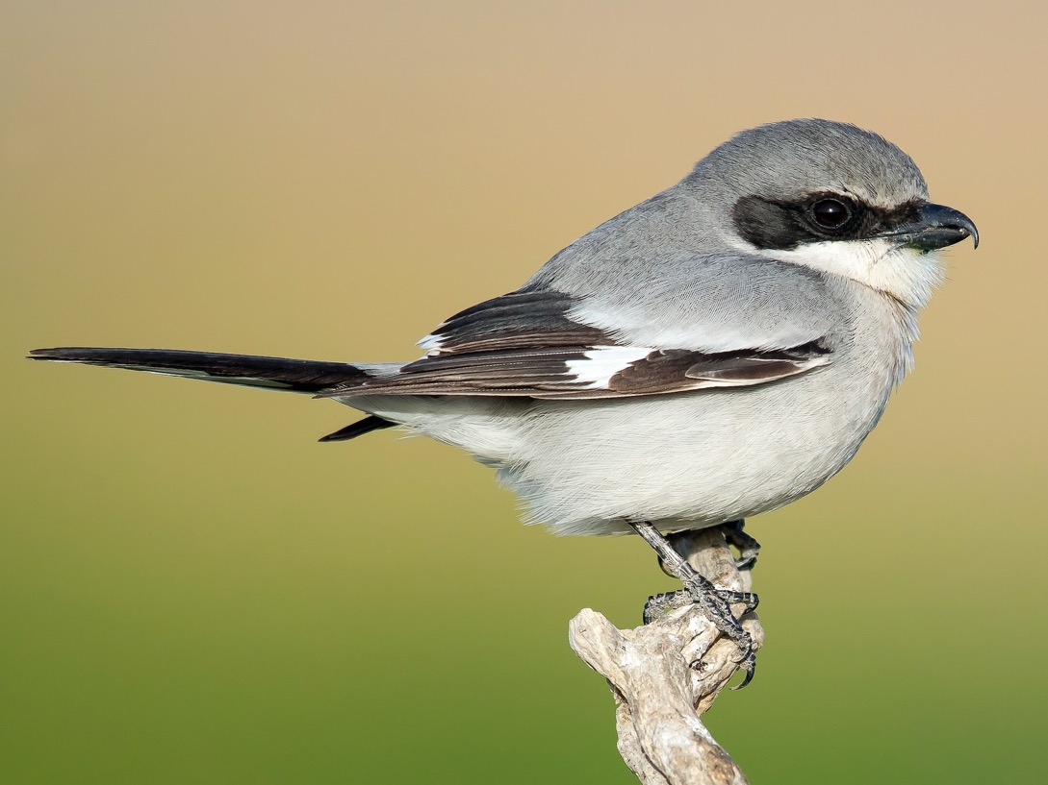
Loggerhead Shrike

Slide 23
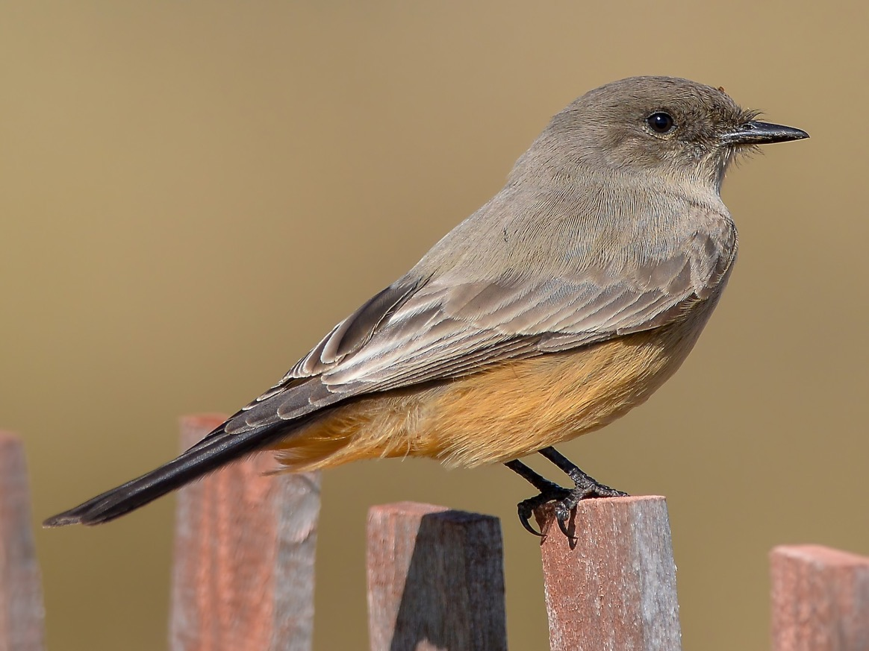
Say’s Phoebe

Slide 24
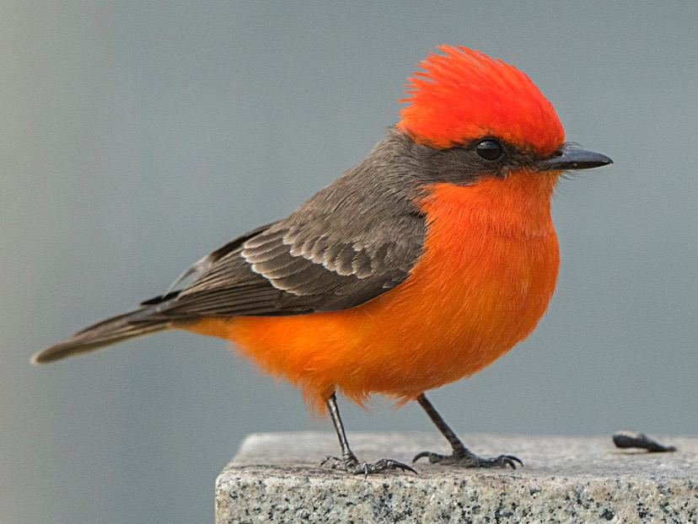
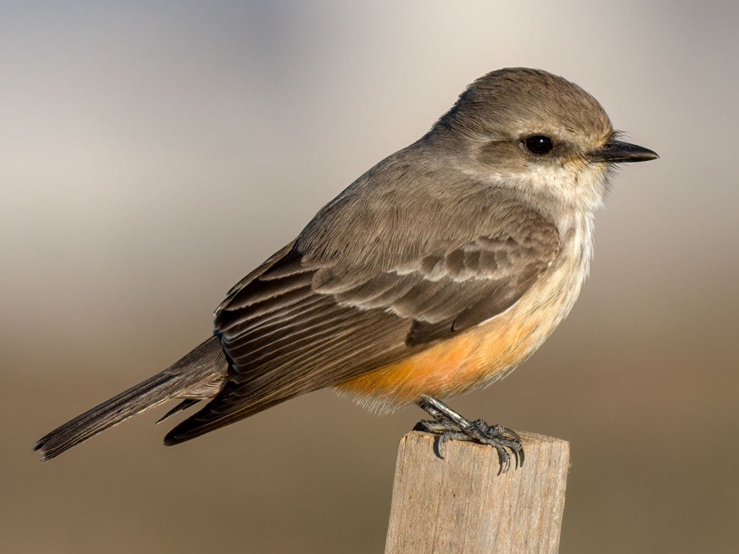
Vermillion Flycatcher
Male
Female

Slide 25
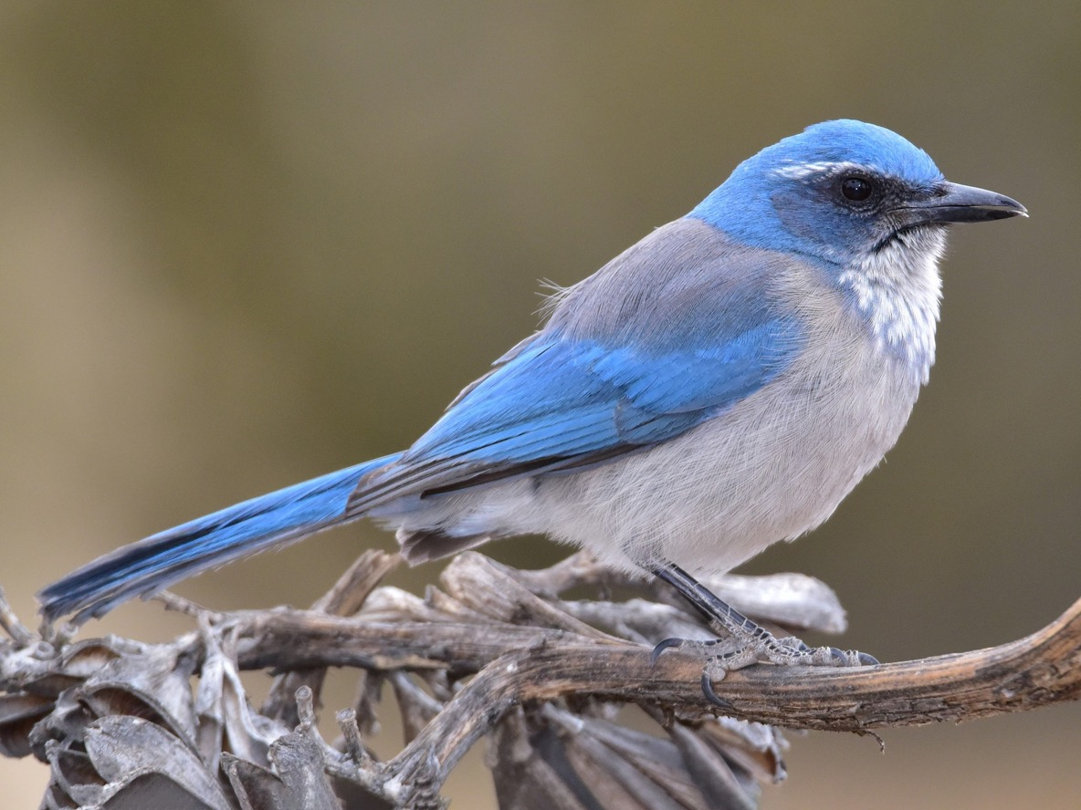
Woodhouse’s Scrub-Jay

Slide 26
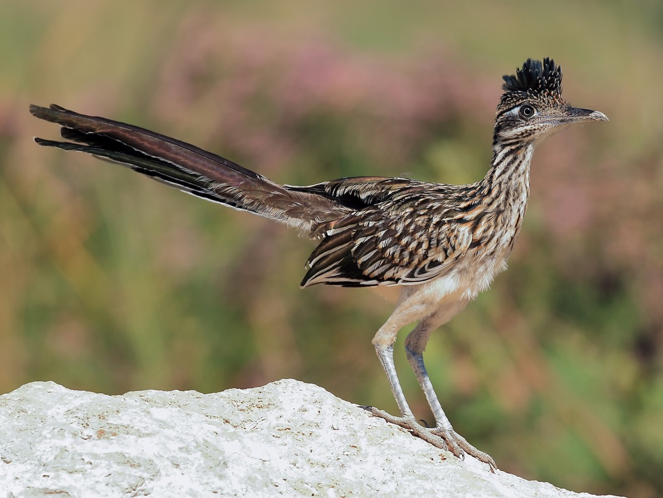
Greater Roadrunner

Slide 27
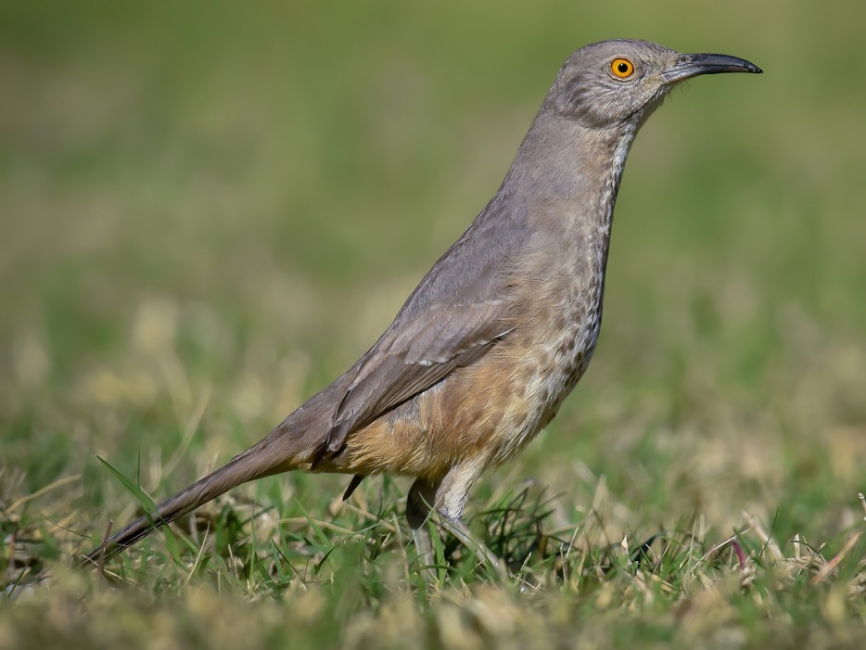
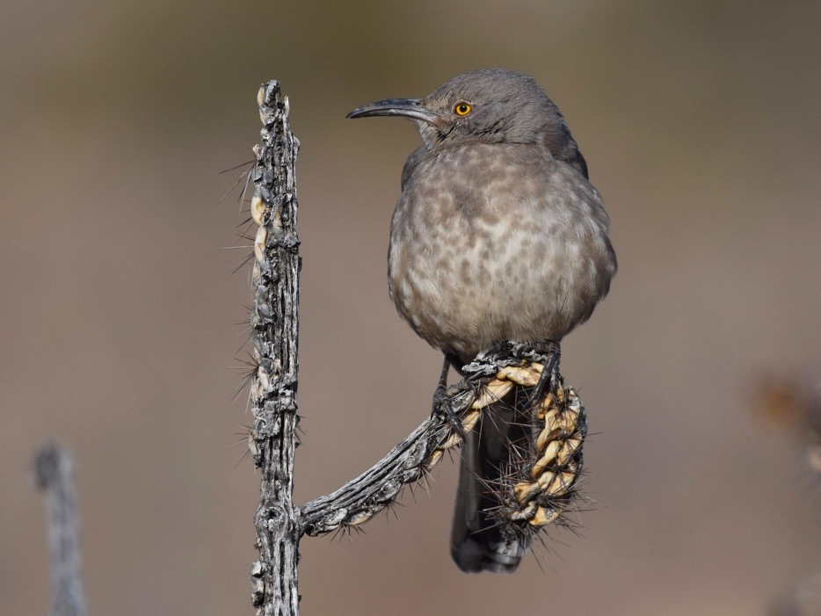
Curve-billed Thrasher

Slide 28
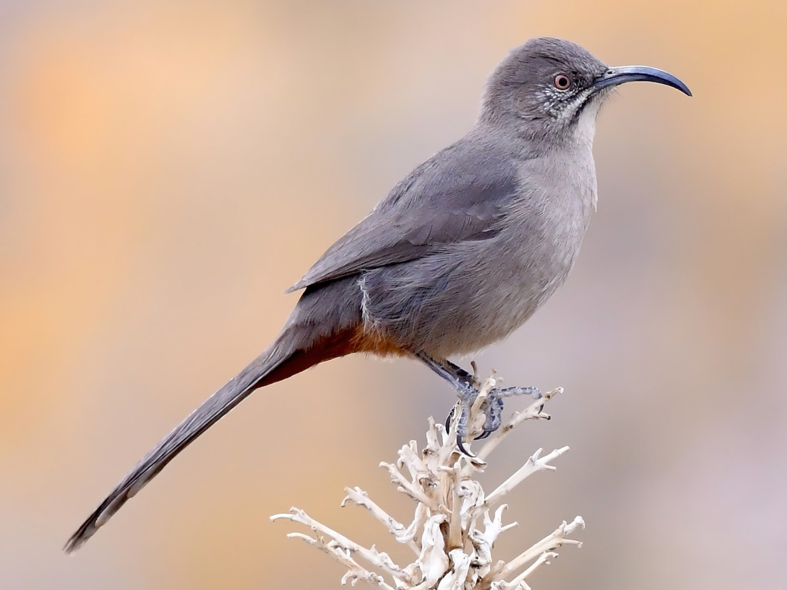
Crissal Thrasher

Slide 29
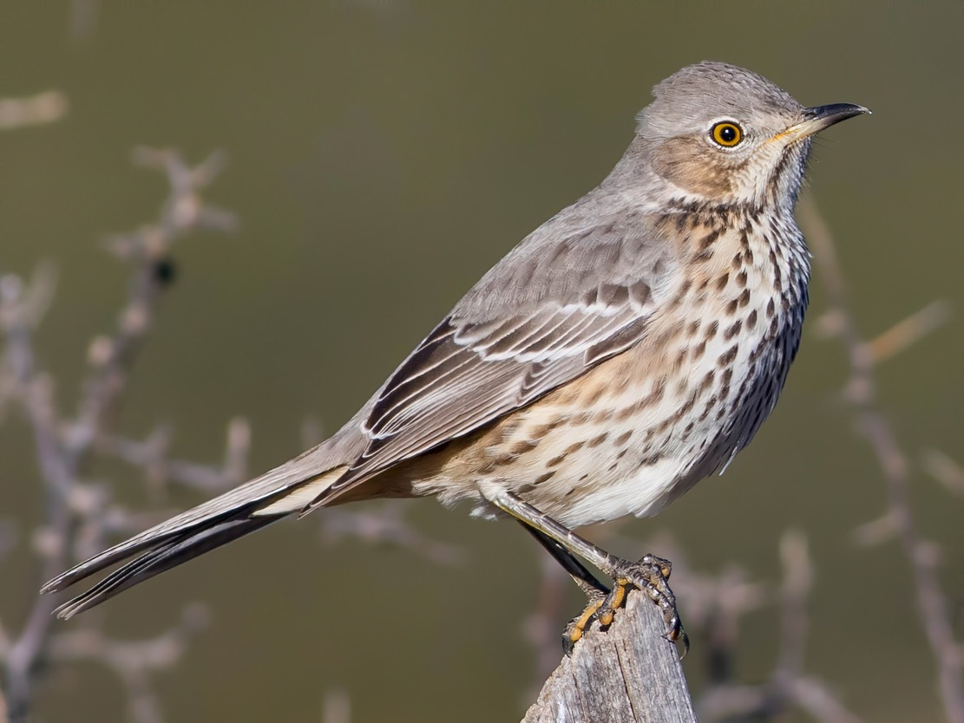
Sage Thrasher

Slide 30
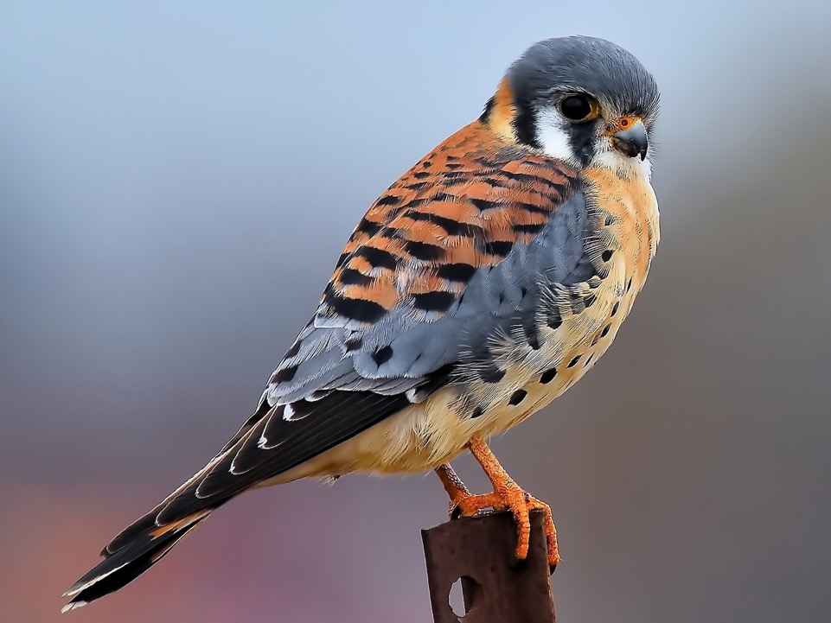
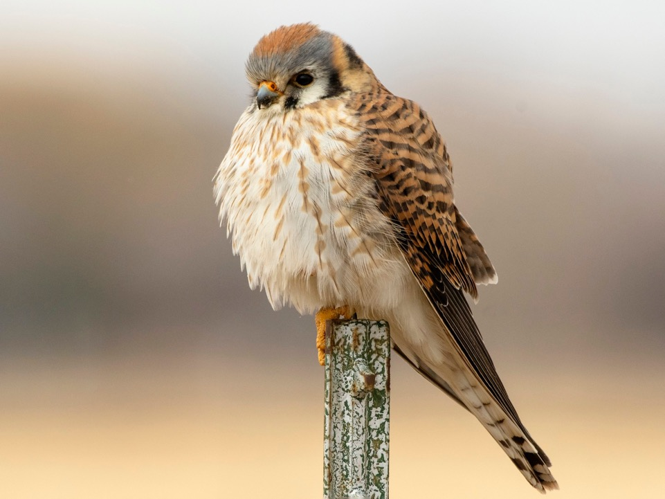
American Kestrel
Male
Female

Slide 31
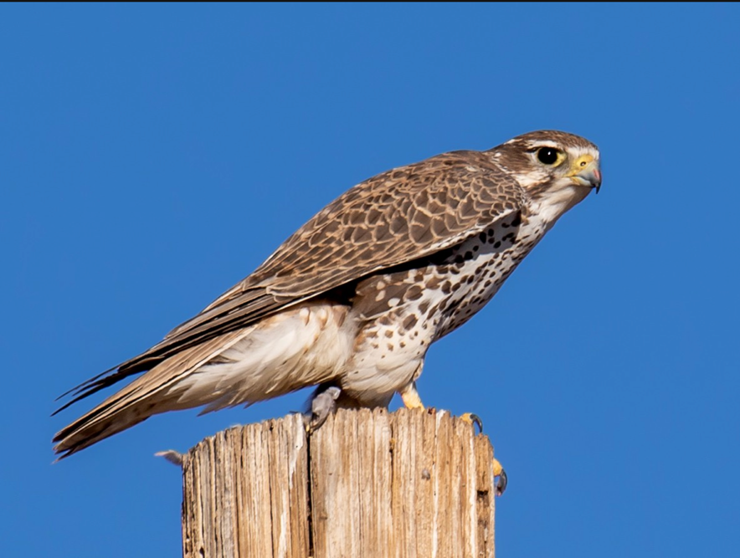
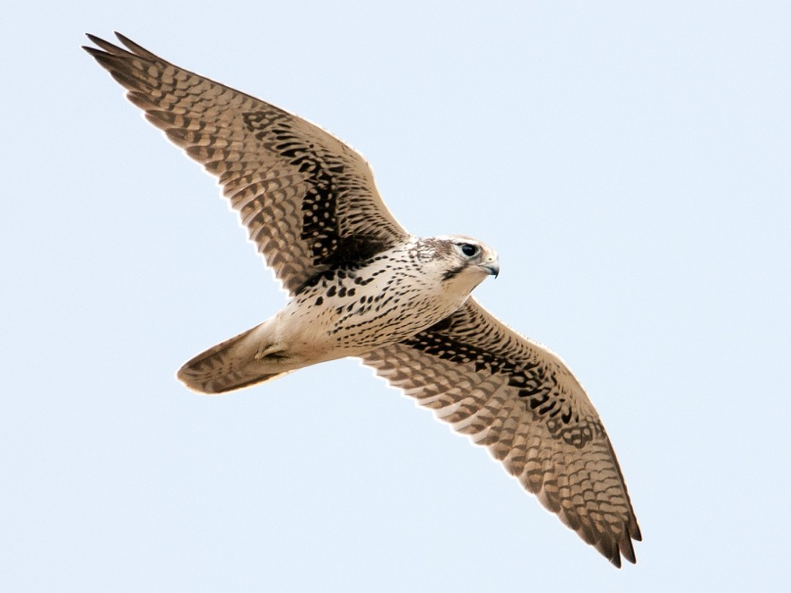
Prairie Falcon

Slide 32
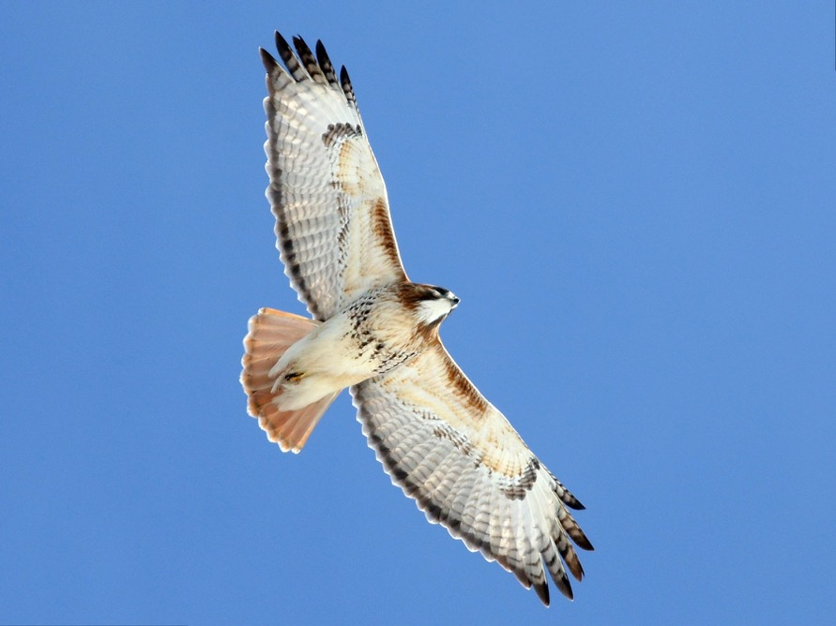
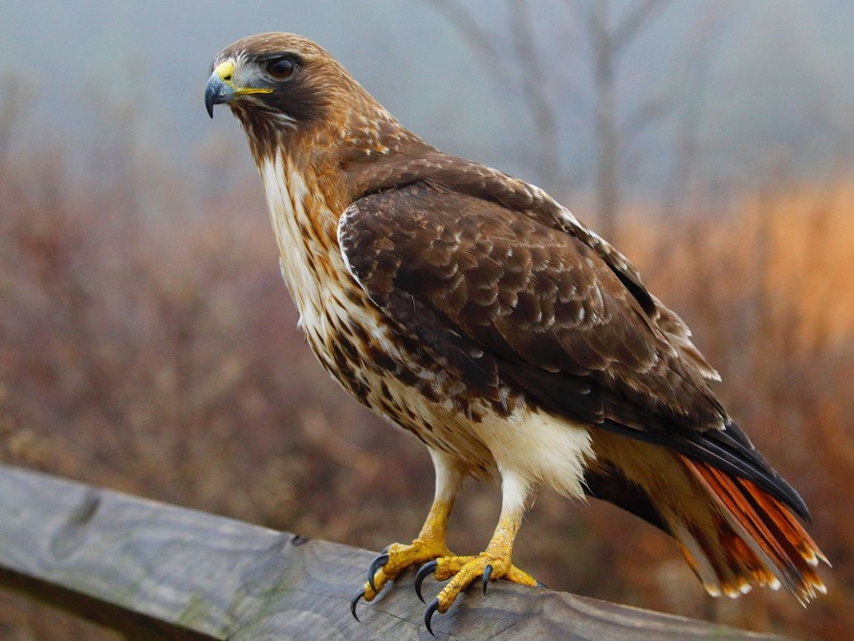
Red-tailed Hawk

Slide 33
Golden Eagle

Slide 34
Chihuahuan Raven

Slide 35
American Crow

Slide 36
Great-tailed Grackle
Male
Female

Slide 37
Brewer’s Blackbird
Male
Female

